Slide 1

Essential Concepts & Inputs for B.M.S.C.E Students
Organised by
ISE Student Club, Information Science and Engineering
Dr. M Dakshayani (HOD)
Student Facilitator- Nilansh Thakur
Coordinated by- Dr. Roopa R

Slide 2
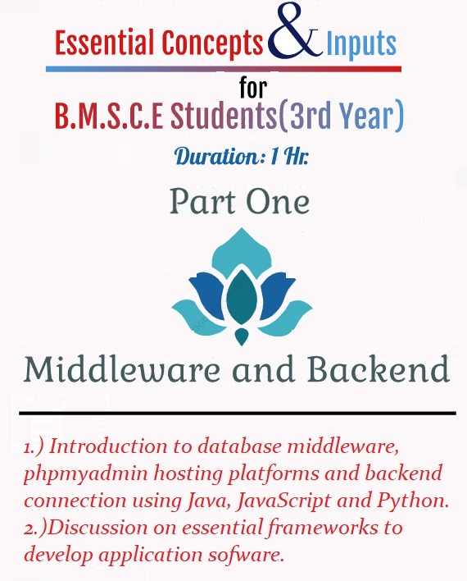
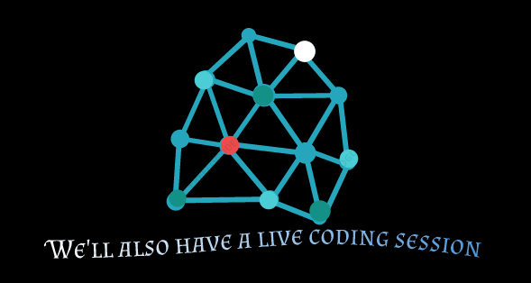
Topics we’ll discuss today:
A Brief Introduction to Middleware
How is middleware an essential component to integrate distributed applications?
What is database middleware and how it plays a crucial role in functionality of an application software
Few examples of phpMyAdmin hosting platforms
Your projects which can be scaled up in minutes
Emphasis to the free ones 😄

Slide 3
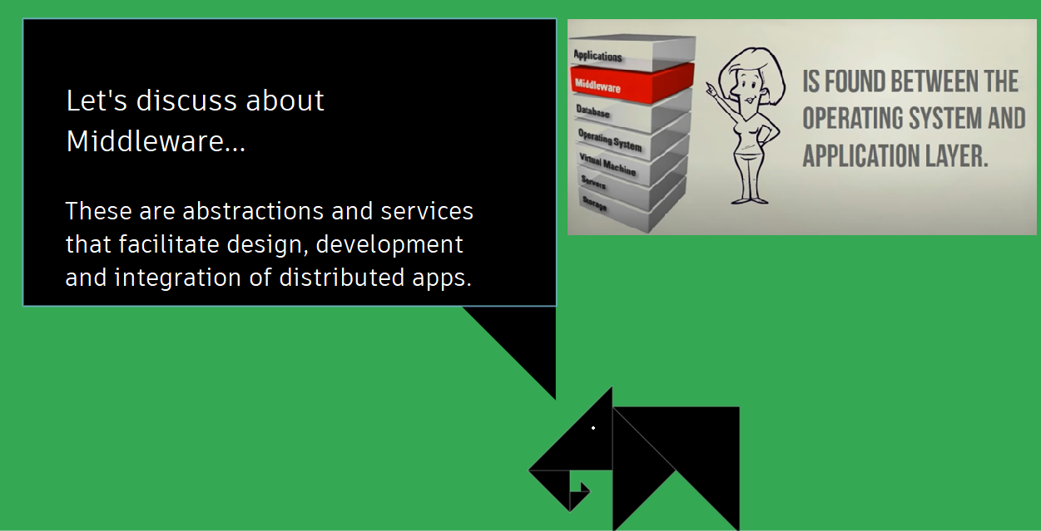
Introduction to Middleware

Slide 4
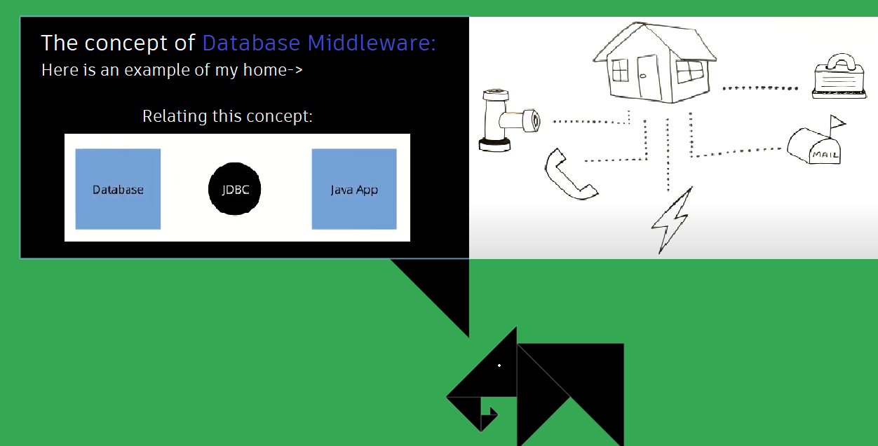
Database Middleware

Slide 5
Now that we are aware of these concepts..
It’s time to have a live coding session

Slide 6
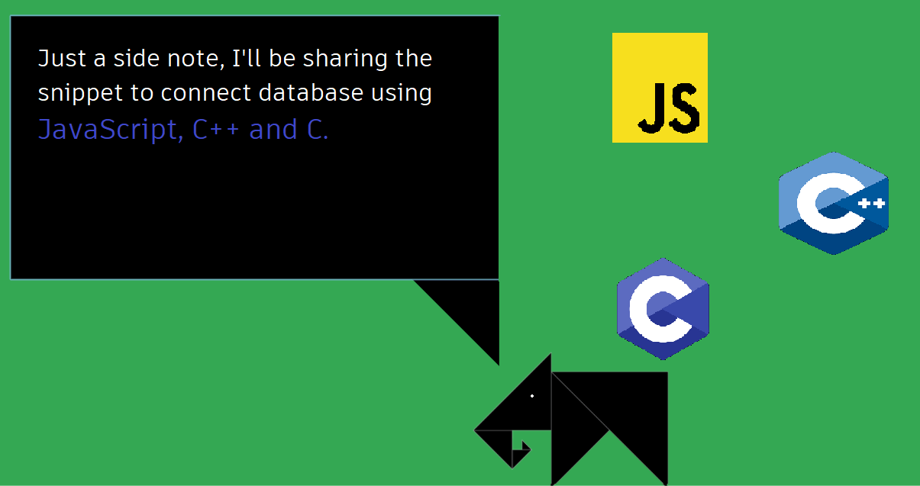

Slide 7



Few examples of phpMyAdmin hosting platforms
Clever Cloud
Heroku
PythonAnywhere
cPanel

Slide 8
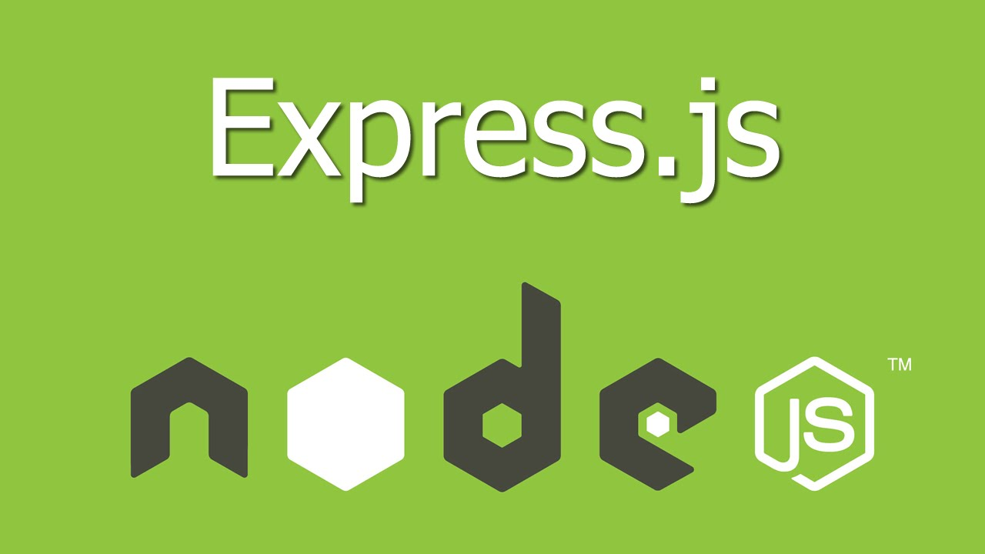
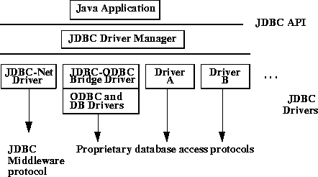

Let’s discuss a few Frameworks to develop Application Software
Django- Python programming
Express.js- JavaScript
Swing- GUI Framework for Java
Spring JDBC Driver- API for Java

Slide 9
Bibliography
https://www.youtube.com/watch?v=S8sgGXUqw30 Middleware concepts by regisuniversityscis
https://www.youtube.com/watch?v=VvGjZgqojMc Spring framework tutorial which comprises Spring Boot and JDBC
https://docs.oracle.com/cd/E13203_01/tuxedo/tux71/html/addist2.htm Distributed Applications documentation
https://docs.google.com/presentation/d/1kSuQyW5DTnkVaZEjGYCkfOxvzCqGEFzWBy4e9Uedd9k/edit#slide=id.g168a3288f7_0_58 Inspiration for the presentation concept
https://link.springer.com/referenceworkentry/10.1007%2F978-0-387-39940-9_689#:~:text=Database%20middleware%20is%20a%20generic,back%2Dend%20in%20a%20larger Springer definition for database middleware
https://www.youtube.com/watch?v=L72fhGm1tfE Comprehensive tutorial to get started with express Js
https://www.youtube.com/watch?v=F5mRW0jo-U4 Django framework crash course

Slide 10
Thank You

